Slide 1
Topic: Bivariate Data EQ: What is Correlation?

Slide 2
Contents
Glossary or Formula Page
Page
Date
Description
2
3

Slide 3
Tasks
24
7
30
Essential Question
Questions
Notes
Summary
4
5

Slide 4
24
7
30
Date
Bivariate Data
EQ: What is correlation?
What is Correlation?
5

Slide 5
24
7
30
Date
Bivariate Data
EQ: What is correlation?
What is Correlation?
A correlation indicates a relationship between two variables
What are the types of relationships?
5

Slide 6
24
7
30
Date
Bivariate Data
EQ: What is correlation?
What is Correlation?
A correlation indicates a relationship between two variables
What are the types of relationships?
5

Slide 7
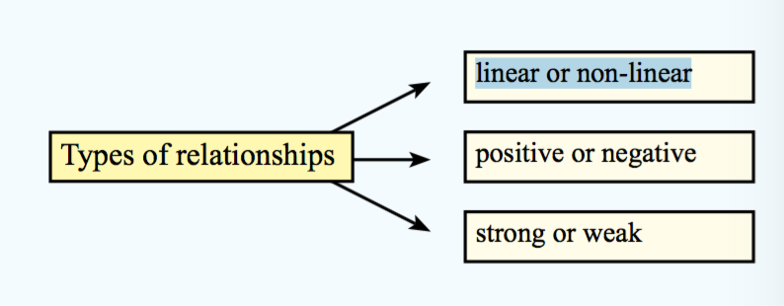
24
7
30
Date
Bivariate Data
EQ: What is correlation?
What is Correlation?
A correlation indicates a relationship between two variables
What are the types of relationships?
5

Slide 8
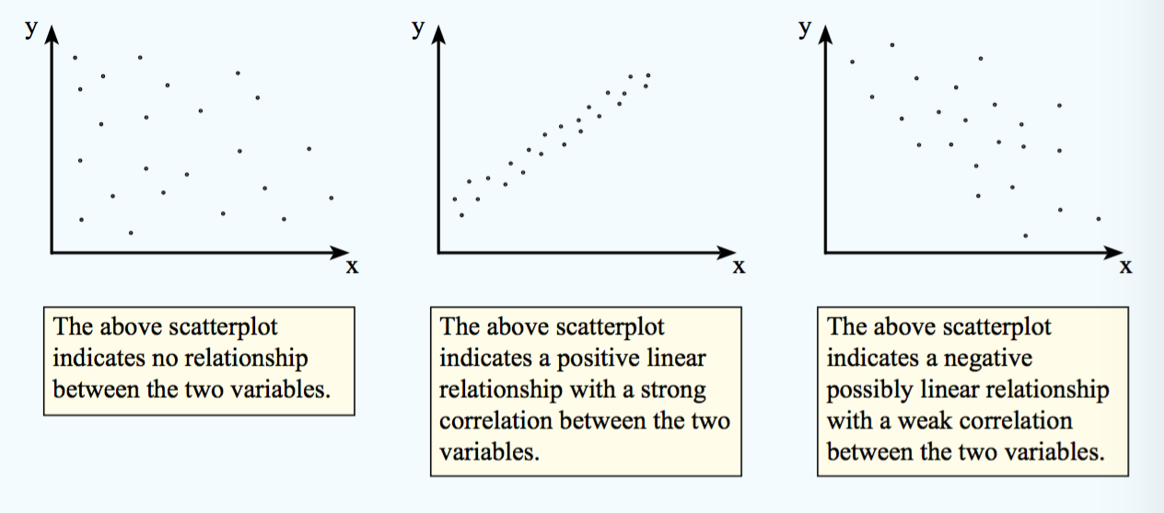
24
7
30
Date
Bivariate Data
EQ: What is correlation?
5

Slide 9
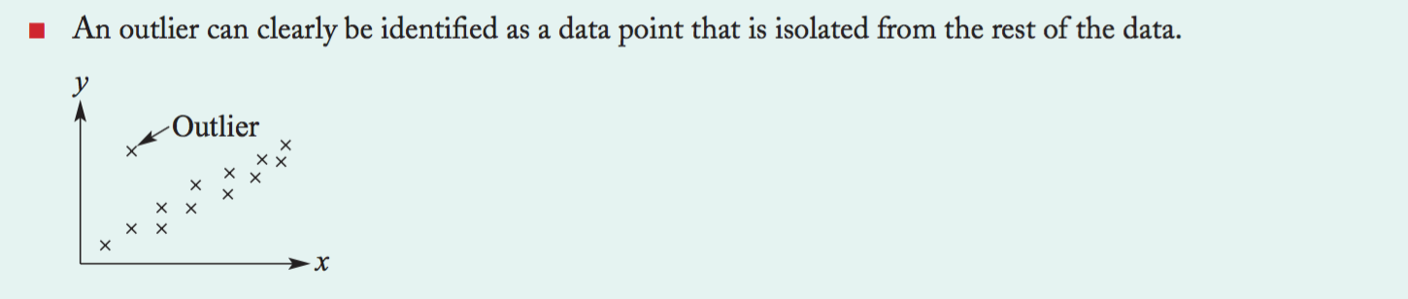
24
7
30
Date
Bivariate Data
EQ: What is correlation?
5

Slide 10
Notes Review
24, 7 ,30
Date
Title
Essential question
Notes complete
Notes complete with colour and diagrams
Questions completed
Contents page filed in
Formula page filled in

Slide 11
Homework
Review your notes and write a summary answering the essential question.

